Slide 1
Welcome!
[24-25] School Year
8th Grade U.S/ NC History
Mrs. Smith

Slide 2
Agenda/Topics to Be Covered
Course Overview
Teacher Information
Classroom Policies
Course Expectations
Grading
Resources
Summary

Slide 3
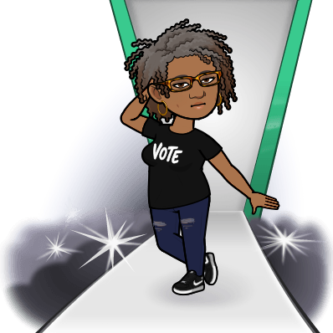
Teacher Information
Angela Smith
B.A History North Carolina Central University
M.Ed. Walden University
North Carolina License in Secondary Social Studies
22nd year teaching, 15 years in Maryland and 6 years with GCS
Email smitha8@gcsnc.com
Remind C1(mhssas1) C2 (mhssas2) C3 (mhssas3) C4 (mhssas4)

Slide 4
Weekly Outlook
A weekly agenda will be posted on Canvas.
Do Nows and Homework will be posted in the agenda
There will be a weekly vocabulary quiz on Friday based on the readings from the week.
CNN10 Newscast will be viewed on Fridays after the vocabulary quiz.
Unit Tests will be announced a least a week prior to administration.

Slide 5
Classroom Policies/Expectations
All assignments are expected to be turned in no later than the Monday of the following week in which they are assigned. There will be a 15-point deduction for late assignments. Assignments turned in more than two week’s late will not be accepted.
Exceptions will be made for student whose absence was excused. If needed extensions will be provided.
Students are expected to keep current with class when absent by following the weekly agenda posted in Canvas and reaching out to the teacher with any concerns or questions.

Slide 6
Classroom Policies/Expectations
Students are to conduct themselves respectfully in class.
Profanity, disruption of the class, and disrespect of any type will not be tolerated.
We will adhere to the cellphone policy outlined in the handbook
We will adhere to the bathroom schedule on the board.
Students must be responsible to bring all materials to class. Being unprepared does not excuse you from completing assignments.
binder, 2 two pocket folders, spiral notebook, pencils, pens, highlighter, loose leaf paper, corded ear phones

Slide 7
Grading
Don’t be overconsumed with grades, focus on your learning and growth.
All assignments will not go in the grade book but must be done with fidelity and your best efforts. I will not discuss what assignments will be included in your final grade. It is up to my discretion. Your job is to do your best.
Homework/Classwork 40% Participation 10%
Quizzes 30%
Tests 20%

Slide 8
Grading
Your grades for this class will be entered into Power School only.
It will be your responsibility to keep up with your assignments.
Assignments in Power School will have codes.
Blue Incomplete- means the assignment is still open for completion
Orange Missing- means the assignment was never done and the assignment is no longer open for completion or being accepted.
Purple Exemption –you are exempt from this assignment

Slide 9
Resources
The following platforms will be used in class.(this is subject to change)
Discovery Ed CNN10 Actively Learn Nearpod Mission U.S Flocabulary

Slide 10
Any Questions?

